Slide 1

Comprehensive Digital Marketing
Project Work

Slide 2
THE TEAM MEMBERS ARE :
1.) Tirunagari chaitanya vasanth : 720131605242 ( Team leader )
2.) Lakkaraju resha Abhishek : 720131605234
3.) Rongala Sudheer : 720131605236
4.) Rokkam SaiGeeta :. 720131605235
TEAM MEMBERS are :
1.). Tirunagari chaitAnya vasanth : 720131605242 ( Team leader)
2.) Lakkaraju resha Abhishek :
3.) Rongala sudheer : 720131605236
4.) RokkamSaiGeeta : 720131605235
RokkamSaiGeeta, Regd num- 720131605235

Slide 3

Part 1: Brand study, Competitor Analysis & Buyer’s/Audience’s Persona
Research Brand Identity: Study the brand's mission, values, vision, and unique selling propositions (USPs).
Mission/Values:
Review, recreate and rediscover the trend of healthy eating and innovate and invent fresh new methods to nourish and delight everyone we serve.
Core emphoysis is an delivering healthy, delicious,delight traditional foods, Indian taste,delight persistent focus is on quality and focus.
USP : Wide range of hygienic, tasty and authentic Indian savories and sweet
Logo :
Tagline : Dont eat at home today; Always in good taste

Slide 4
Part 1: Brand study, Competitor Analysis & Buyer’s/Audience’s Persona
Analyze Brand Messaging: From many formative years, the haldiram company instilled the value of keeping the tradition and quality intact, even as they matured as a company. All the products maintain a consistent sense of simplicity. The ingredients and recipes were picked to accentuate these ideas and are followed to this date. The brand promisest that all products are natural, wholesome and have a homemade feel to them.
Although, Haldiram’s is about more than just food. By creating a strong sense of community and supporting to associates and to continue to feel like a true family business.The brand carry these values as they operate together to serve generations of happy connoisseurs across the globe and continue to be the nation’s beloved snack-food company.

Slide 5
Part 1: Brand study, Competitor Analysis & Buyer’s/Audience’s Persona
. Examine the brand's tagline: As the age old saying goes, “The way to one’s heart courses through their stomach”. We want to leave no stone unturned to win your hearts.
Through the tagline “Delicious bhi Dooriyaan bhi” the brand emphasises on the seating arrangement where consumers are requested and restricted to maintain 6 feet distance from individuals to create a temporary practise of social distancing for safe dining experience and to maintain the permanent love of Haldiram's.”.
Through the tagline “Delicious bhi Dooriyaan bhi” the brand emphasises on the seating arrangement where consumers are requested and restricted to maintain 6 feet distance from individuals to create a temporary practise of social distancing for safe dining experience and to maintain the permanent love of Haldiram's.

Slide 6
Part 1: Brand study, Competitor Analysis & Buyer’s/Audience’s Persona
Competitor Analysis: Select three competitors operating in the same industry or niche as the chosen brand, examine their USPs and online communication.
Competitor 1: https://www.dabur.com
USP : All Round Sales, Wide Variety of products like Skin Care, Daily house needs, kids products etc,
Communication: Social media, Costumer care
Competitor 2: https://www.patanjaliayurved.net
USP : Food Products, skin care
Communication: Costumer care, phone call
Competitor 3: https://www.lays.com/
USP : Chips production rich in Indian taste standards
Communication: Costumer care, phone call

Slide 7
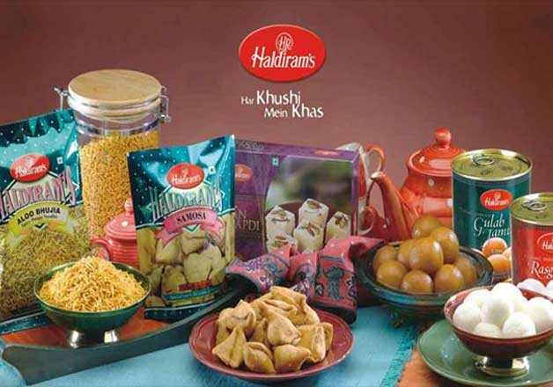
Part 1: Brand study, Competitor Analysis & Buyer’s/Audience’s Persona
Buyer's/Audience's Persona: Clearly define the target audience for the chosen brand. Consider demographics, psychographics, behaviors, and interests.
Haldiram’s
T. Yeswanth
Male
35 years
Married
Metro city - Hyderabad
10,00,000/- per annum
Adv, Yotube, Instagram, Facebook, Socail media, TV Etc
Brand Value : Taste, Packing, Distribution, ingredients, brand, review

Slide 8
Part 2: SEO & Keyword Research
SEO Audit: Do an SEO audit of the brands website
Keyword Research: Define Research Objectives, Brainstorm Seed Keywords, Utilize Keyword Research Tools (SEMrush or Moz Keyword Explorer),Analyze Competitor Keywords, Long-tail Keyword Exploration (specific, longer phrases) that align with the research objectives and have lower competition but higher conversion potential.
On page Optimization: Meta Tag optimization & content optimization
Reflect on the process of conducting keyword research and the SEO recommendations provided.
Document the challenges faced during the research and analysis phase, as well as the key insights gained from the keyword research process.

Slide 9
There are challenges which are faced during this proces and analysis phase ,such as in keyword research analysis,Social media presence, on seo and on page optimization proces.
Keyword Analysis: Identifying the relevant keywords related to Haldiram's products and services. Checking if these keywords are strategically used in the website's content.
On-Page SEO: Evaluating the website's title tags, meta descriptions, headings, and content. Ensuring they are optimized with target keywords and relevant information.
SEMrush: A comprehensive SEO tool that offers keyword research, competitor analysis, and more.
Competitor Analysis: By Use the tool to analyze competitor websites to discover additional keyword opportunities and potential gaps.
Haldiram SEO Audit Default (GPT-3.5) User SEO audit of haldiram ChatGPT As an AI language model, I don't have real-time access to specific websites or data, so I can't perform a live SEO audit of Haldiram. However, I can guide you on conducting an SEO audit for a website like Haldiram. To perform an SEO audit, consider the following steps: Keyword Analysis: Identify relevant keywords related to Haldiram's products and services. Check if these keywords are strategically used in the website's content. On-Page SEO: Evaluate the website's title tags, meta descriptions, headings, and content. Ensure they are optimized with target keywords and relevant information. Technical SEO: Check for crawl errors, broken links, and ensure the website is mobile-friendly and has a fast loading speed. Backlink Analysis: Examine the website's backlink profile to ensure it has quality and relevant backlinks from reputable sources. Local SEO: If Haldiram has physical locations, check if they are listed accurately in local directories and Google My Business. Social Media Presence: Evaluate the social media presence and engagement of Haldiram on various platforms. Competitor Analysis: Compare Haldiram's website and SEO strategies with its competitors to identify areas for improvement.

Slide 10
August 2023
Part 3: Content Ideas and Marketing Strategies
Sun | Mon | Tue | Wed | Thu | Fri | Sat
30 Blog article on sweets | 31 Started content creactio | 1 WWW Day | 2 Instagram story creatio | 3 Video editing | 4 | 5
6 Hiroshima | 7 National handloom day | 8 | 9 Quit India | 10 | 11 | 12
13 | 14 | 15 Independence day | 16 | 17 | 18 | 19
20 | 21 | 22 | 23 | 24 | 25 | 26
27 | 28 | 29 Oman | 30 Raksha bandan | 31 | 1 | 2
Content Idea Generation & Strategy: Create a content calendar for the remaining month of July by brainstorming content themes, exploring various formats like blog posts, videos, infographics, podcasts, and interactive quizzes, and scheduling publication dates mainly on Facebook & Instagram. And include the strategy, aim and the idea behind these posts and story

Slide 11
Part 3: Content Ideas and Marketing Strategies
Reflect on the content ideas and marketing strategies process, discussing the challenges encountered and lessons learned.
CONTENT IDEAS AND MARKETING STR ATEGIES :
Created a content ideas throught by online and Marketing Strategy of Haldirams analyzes the brand with the marketing mix framework which covers the 4Ps (Product, Price, Place, Promotion). These business strategies, based on Haldirams marketing mix, help the brand succeed in the market.
ELECTRONIC COMMUNICATIONS :
When you use any of Haldiram’s services, or reach us via email, you are establishing a communication with us, thereby confirming your consent to receive communications from us electronically. We will communicate with you by e-mail / text message / WhatsApp. You agree that all agreements, notices, disclosures and other communications that we provide to you electronically satisfy any legal requirement that such communications be in writing.
TRADEMARKS:
In addition, graphics, logos, page headers, button icons, scripts, and service names included in or made available through any service are trademarks or service mark of Haldiram’s or its affiliates or its content suppliers does not get any right for copying or using the same by availing the services.
DISPUTES:
Any dispute or claim relating in any way to your use of any Haldiram’s Products / Service, or to any products or services sold or distributed by Haldiram’s or through www.haldiram.com will be subject to exclusive jurisdiction of the court of Delhi.

Slide 12
Reflect on the content ideas and marketing strategies process, discussing the challenges encountered and lessons learned.
Product Quality and Innovation: Haldiram has built a reputation for high-quality products. They likely focus on maintaining product excellence and continuously innovating to introduce new and unique offerings to the market.
Distribution Network: Haldiram probably maintains an extensive distribution network to ensure its products are widely available across different regions and markets, including retail stores, supermarkets, and online platforms
Brand Recognition and Visibility: Haldiram invests in building and maintaining its brand identity through consistent branding, attractive packaging, and extensive advertising across various channels like TV, print, online, and social media.
Celebrity Endorsements: The brand might engage popular celebrities or influencers to promote its products and increase brand visibility.
Promotions and Offers: Haldiram likely runs periodic promotional campaigns, discounts, and offers to attract customers and boost sales, especially during festive seasons.

Slide 13
Part 4: Content Creation and Curation (Post creations, Designs/Video Editing, Ad Campaigns over Social Media and Email Ideation and Creation)
Post Creation:
Select Content Categories: Identify three different content formats relevant to the chosen topic or industry. Research and Brainstorm: Research trending topics, industry news, or audience interests within each category. Brainstorm ideas for social media posts that align with each category. Do note that 1 content format has to be video and additionally 3 stories/status are to be created.
Format 1 - Blog article
Format 2 - Video
Format 3 - Creative

Slide 14
FORMAT 1 - Blog article
Aim: Boost SEO & provide information about a certain new product
Date : 27th July 2023
Idea : Haldiram has launched new Project as Pack Kiya kya
Topic : Haldiram's has introduce its latest Project, titled"Haldiram's Pack Kiya Kya?" encouraging customers to bring along their preferred Ready-to-Eat (RTE) food packs from Haldiram's for a home-like experience while traveling.

Slide 15
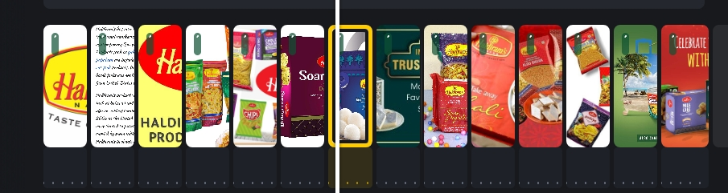
FORMAT - 2 : Video
Aim : To promote newly launched haldiram's all in one namkeens
Date : 29th July 2023
Idea : Haldiram's has newly launched all in one namkeens and it's different products to have a variety of taste.
Topic : All In One by Haldiram's gives everyone a wholesome and filling food experience by tasting the blend of all spicy, salted and sweet namkeens altogether in one form. Cornflakes, nuts, raisins and namkeens come together to make your snack time extra delicious with Haldiram's.aldiram's

Slide 16
FORMAT 3 - Creative :
Aim : Brand awareness and reach
Date : 31st July 2023
Idea : To create a meme on the trending topic : Haldirams Rakhi special food products and it's discounts .
Topic : Rakhi special food products and it's discounts.
For a festive offers , the sweets and food products are gets discounted and maintains a high quality of products to have a aroma of its taste.

Slide 17
Part 4: Content Creation and Curation (Post creations, Designs/Video Editing, Ad Campaigns over Social Media and Email Ideation and Creation)
Instagram Story

Slide 18

Part 4: Content Creation and Curation (Post creations, Designs/Video Editing, Ad Campaigns over Social Media and Email Ideation and Creation)
Designs/Video Editing
Design Tools Familiarization (use Canva for creating visually appealing graphics)
Video Creation: Utilize VN or any video editor of your choice to create videos related to the chosen topic.

Slide 19
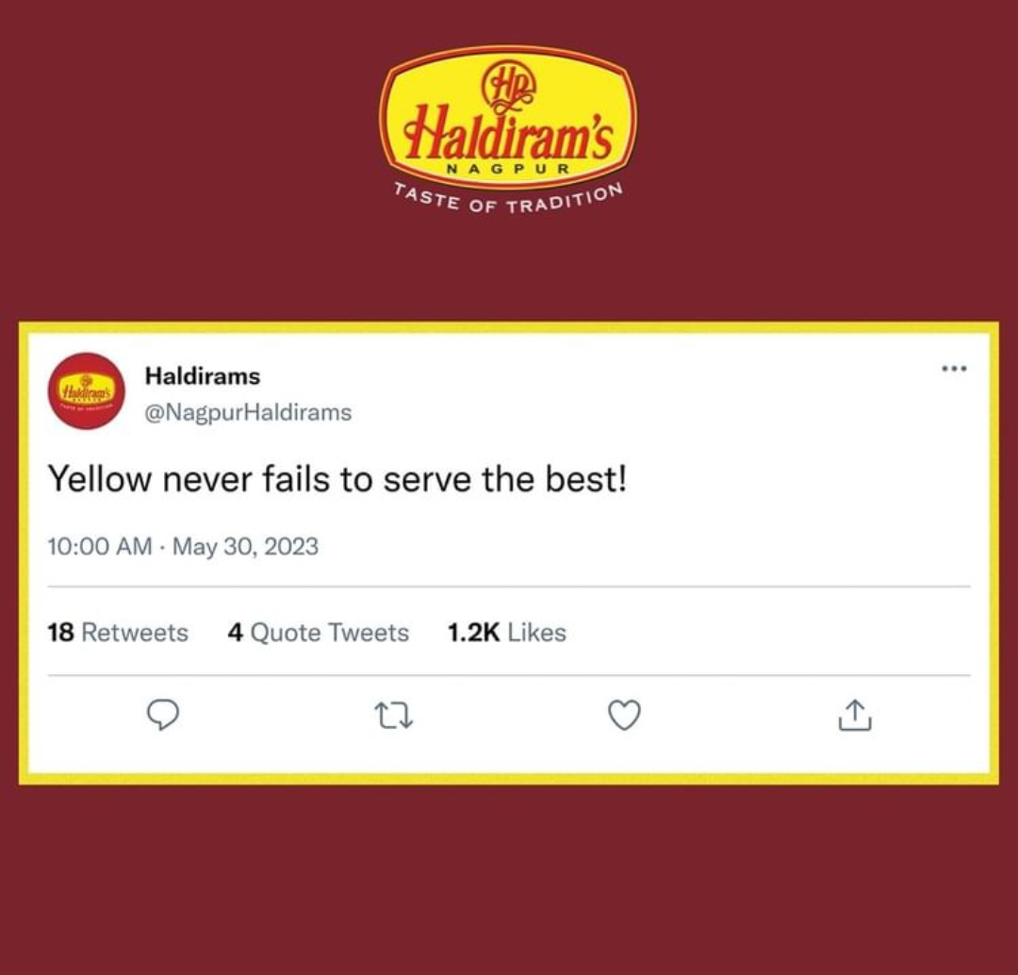
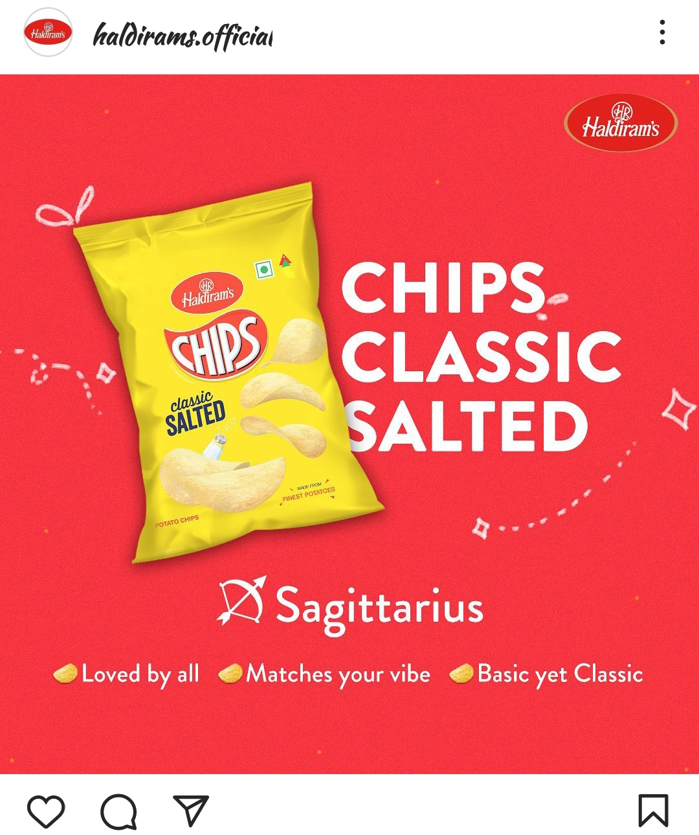
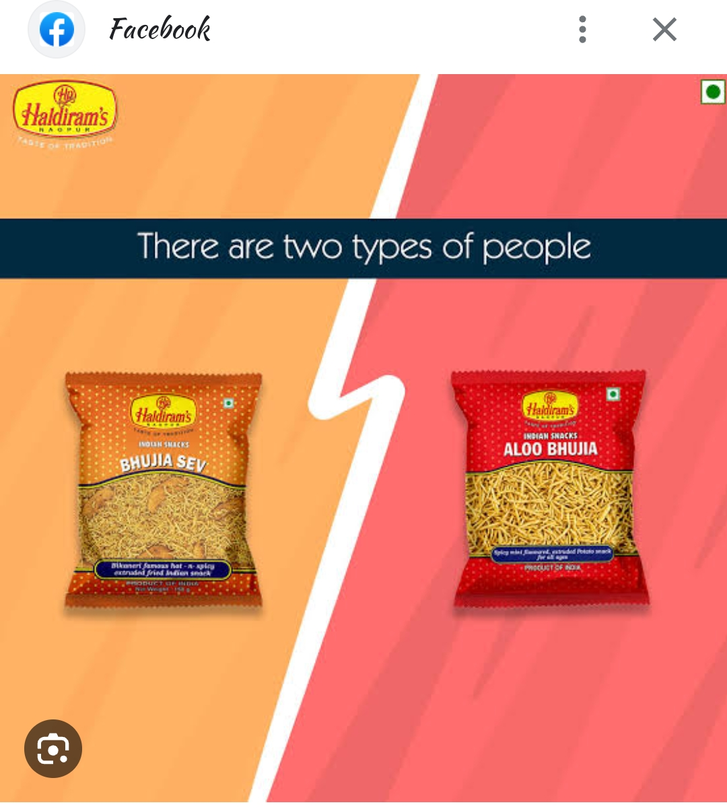
Part 4: Content Creation and Curation (Post creations, Designs/Video Editing, Ad Campaigns over Social Media and Email Ideation and Creation)
Social Media Ad Campaigns
Ad Campaigns over Social Media:
Come up with 3 ad campaigns each covering one of the mentioned goals: brand awareness, driving website traffic, or generating leads -
Haldiram's launches #MilnekaMeethaBahana campaign
Haldiram launches new campaign – Haldiram’s Pack Kiya Kya?

Slide 20

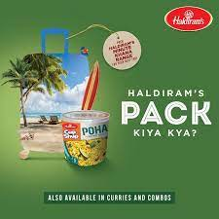
Social Media Ad Campaigns :

Slide 21
Part 4: Content Creation and Curation (Post creations, Designs/Video Editing, Ad Campaigns over Social Media and Email Ideation and Creation)
For every campaign clearly define:
Advertising Goals: increasing brand awareness, driving website traffic, or generating leads.
Audience Targeting: Define the target audience for the ad campaigns based on demographics, interests, and behavior.
Ad Creation: Create visually appealing ad creatives, compelling ad copy and relevant call-to-action.

Slide 22
Part 4: Content Creation and Curation (Post creations, Designs/Video Editing, Ad Campaigns over Social Media and Email Ideation and Creation)
Email Ad Campaigns
Ad Campaigns for email marketing:
Come up with 2 email ad campaigns with the mentioned goals: brand awareness & generating leads

Slide 23

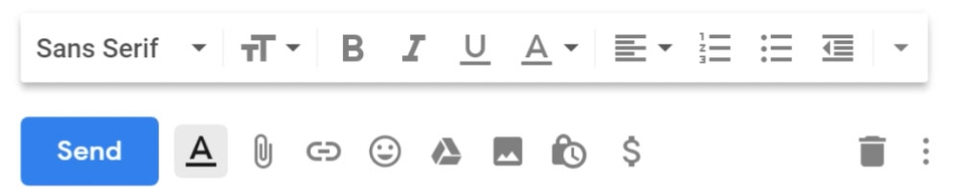
Email Ad Campaign 1 - Brand Awareness
(insert emailer image)
New message:
To : Tadepalliyeshwanth45@gmail.com
Subject: Discover the Irresistible Flavors of Haldiram's!
We hope this email finds you well! We are delighted to introduce you to the world of Haldiram's - a brand that has been captivating taste buds and spreading joy for generations
Why Choose Haldiram's? Rich Heritage: With a legacy spanning decades, Haldiram's has perfected the art of creating delectable treats, cherished by families across the globe. Premium Ingredients: From hand-picked spices to farm-fresh produce, every ingredient is chosen to ensure the most delightful taste in every bite. Diverse Selection: Our extensive range includes an array of savory snacks, mouthwatering sweets, and delightful beverages, catering to every palate.
Website: www.haldirams.com | Contact: support@haldirams.com | Social Media Links: Facebook, Instagram, Twitter]
New message
Subject: Discover the Irresistible Flavors of Haldiram's!

Slide 24

Email Ad Campaign 2 - Lead Generation
(insert emailer image)
New message
To : Tadepalliyeshwanth45@gmail.com
Subject Line: Discover the Exquisite World of Haldiram's Delights!
Dear [Recipient's Name], We hope this email finds you in high spirits. We are thrilled to introduce you to the captivating world of Haldiram's, where taste meets tradition in every bite!
🍬 A Symphony of Flavors 🍬 Explore our vast array of delectable products, from savory namkeens to mouthwatering sweets. Each bite is a symphony of flavors, crafted with love and perfection, and representing the rich culinary heritage of India. 💚 Our Belief in Sustainability 💚 At Haldiram's, we not only care about your taste buds but also our planet. Our eco-friendly practices and responsible sourcing demonstrate our dedication to a sustainable future.
Subject Line: Discover the Exquisite World of Haldiram's Delights!
Thank you for being a part of the Haldiram's family. We look forward to indulging your taste buds and sharing the joy of our authentic Indian flavors with you.Warm regards, The Haldiram's Team
🍬 A Symphony of Flavors 🍬 Explore our vast array of delectable products, from savory namkeens to mouthwatering sweets. Each bite is a symphony of flavors, crafted with love and perfection, and representing the rich culinary heritage of India. 💚 Our Belief in Sustainability 💚 At Haldiram's, we not only care about your taste buds but also our planet. Our eco-friendly practices and responsible sourcing demonstrate our dedication to a sustainable future. 👫 Join Our Happy Community 👫 Join a community of satisfied customers who have experienced the joy of Haldiram's treats. We value your loyalty and strive to exceed your expectations with every mouthwatering delicacy. 🎁 Special Offer Just for You 🎁 As a token of our appreciation, we have an exclusive offer for you. Use the code "TASTYHALDI" to enjoy a 15% discount on your first online order. 🔎 Explore Haldiram's Today 🔍 Ready to embark on a delightful journey of taste and tradition? Visit our website or drop by our nearest store to experience the magic of Haldiram's for yourself. 📢 Stay Connected 📢 Follow us on social media to stay updated on the latest news, contests, and delicious surprises! Facebook: [Facebook Handle] Instagram: [Instagram Handle] Twitter: [Twitter Handle] 🤝 We Value Your Feedback 🤝 Your satisfaction matters the most to us. Feel free to share your thoughts or any suggestions; we'd love to hear from you! Thank you for being a part of the Haldiram's family. We look forward to indulging your taste buds and sharing the joy of our authentic Indian flavors with you. Warm regards, The Haldiram's Team [Haldiram's Contact Information] [Unsubscribe Option] Send a message Free Research Preview. ChatGPT may produce inaccurate information about people,
. As a token of our appreciation, we have an exclusive offer for you. Use the code "TASTYHALDI" to enjoy a 15% discount on your first online order.
New message

Slide 25
Part 4: Content Creation and Curation (Post creations, Designs/Video
Editing, Ad Campaigns over Social Media and Email Ideation and Creation)
Reflect on the content creation and curation process, discussing the challenges faced and lessons learned.
During content creation and curation, some common challenges include:
Time and Resources: Creating high-quality content and curating relevant information can be time-consuming and may require substantial resources.
Audience Relevance: Ensuring the content aligns with the target audience's interests and needs can be challenging.
Content Organization: Effectively organizing and categorizing curated content can be challenging to provide a seamless user experience.
Staying Updated: In rapidly evolving industries, staying current with the latest trends and information is crucial but can be demanding.
Challenges

